Slide 1
#UHD Learn Learning Management System
By: Andrew Truong, Daniel fabela, Eduardo rojas, hung ly, Sumanth pisipati

Slide 2
Requirements
To build a student information management system.
The system tracks the details of the student: enrolled courses, progress, exam grades, etc
Instructors are administrators
Able to edit enrolled students grades, add courses taught, delete, etc.
Students are users
Able to view assignments, grades, enrolled courses, etc

Slide 3
Schedule
Deliverable | Description | Dates
Software Project Management Plan (SPMP) | A complete formal project plan, including technical and managerial processes that will be implemented in the development and delivery of the system. | 3/21/2019
Requirement artifacts, analysis artifacts, and presentation of project’s progress. | UML Diagrams of use cases, class diagram, collaboration diagram, and sequence diagram. | 3/21/2019
Product Software | The executable code for the LMS. | 4/28/2019
Final Presentation | A demonstration of the product software. | 4/30/2019

Slide 4
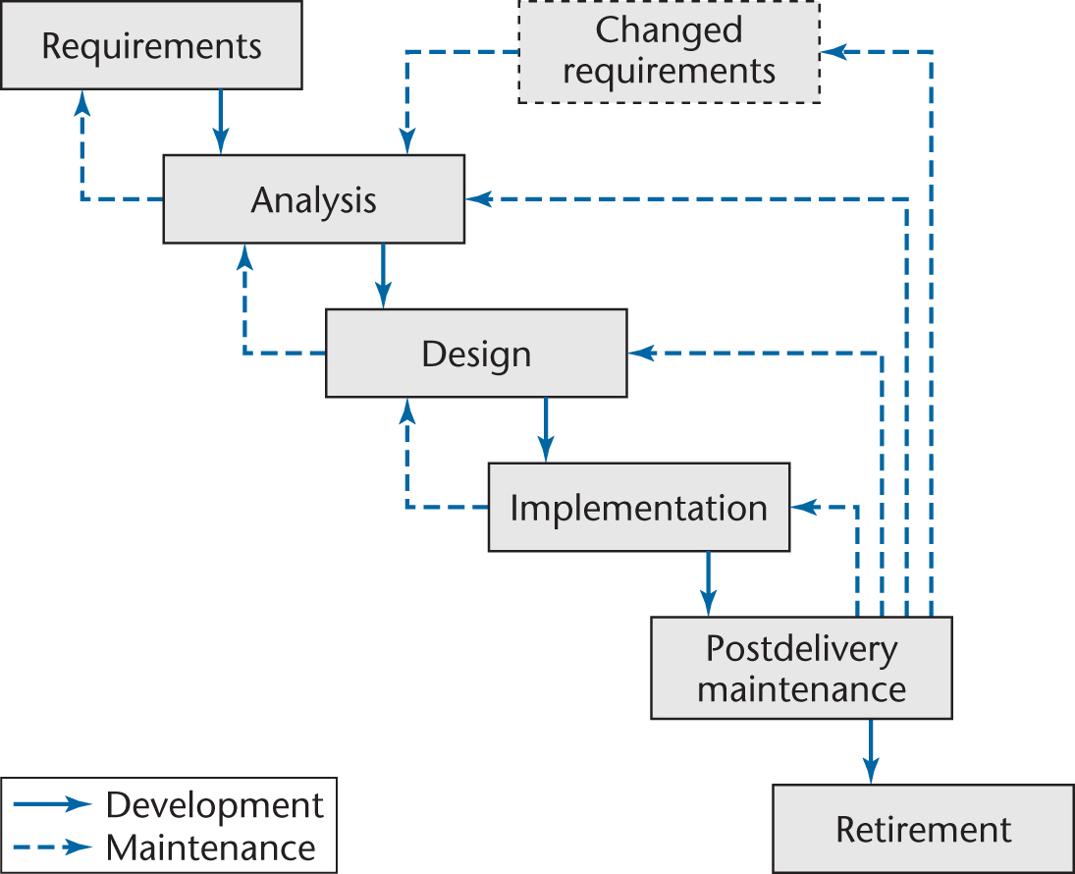
Life Cycle
Waterfall Model

Slide 5
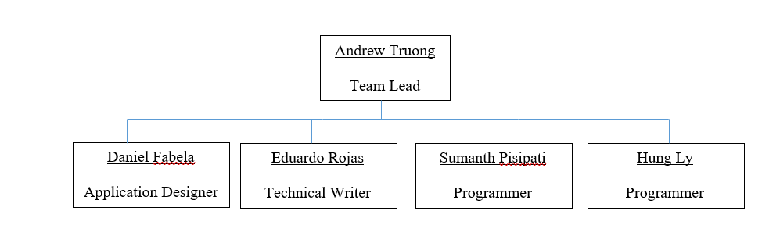
Team Organization

Slide 6
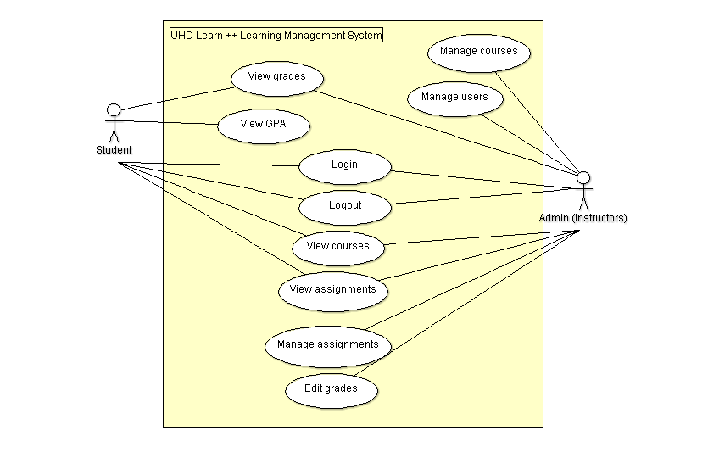
UML Use Case Diagrams

Slide 7
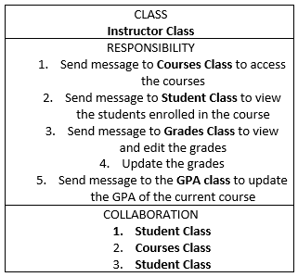
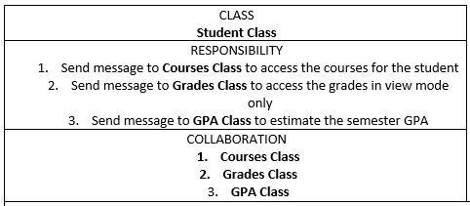
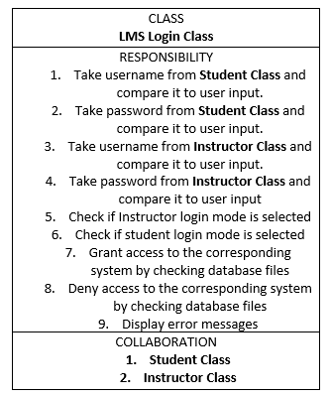
Analysis Workflow
CRC Cards

Slide 8
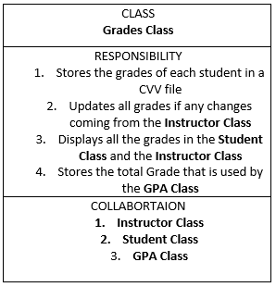
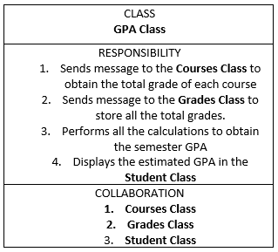
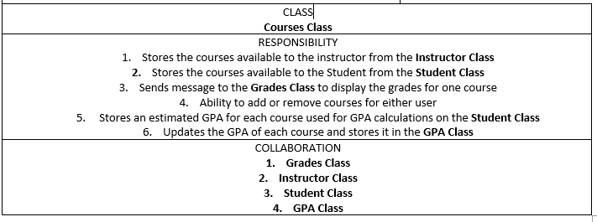
CRC Cards cont.

Slide 9
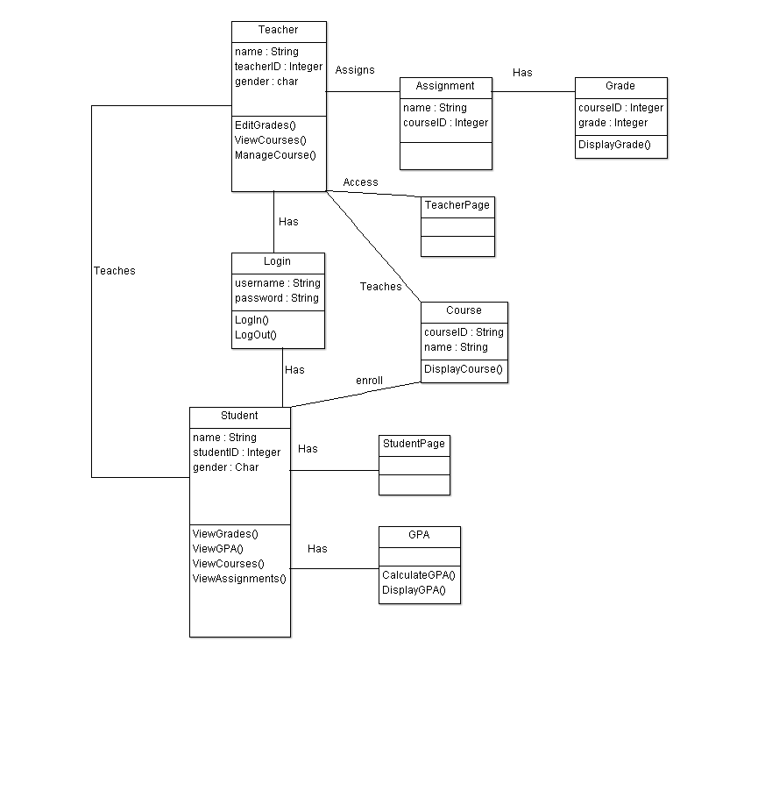
Class Diagram

Slide 10
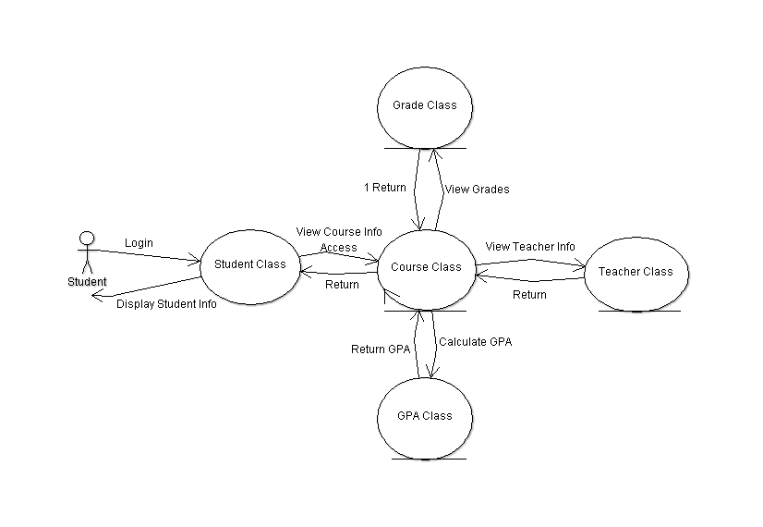
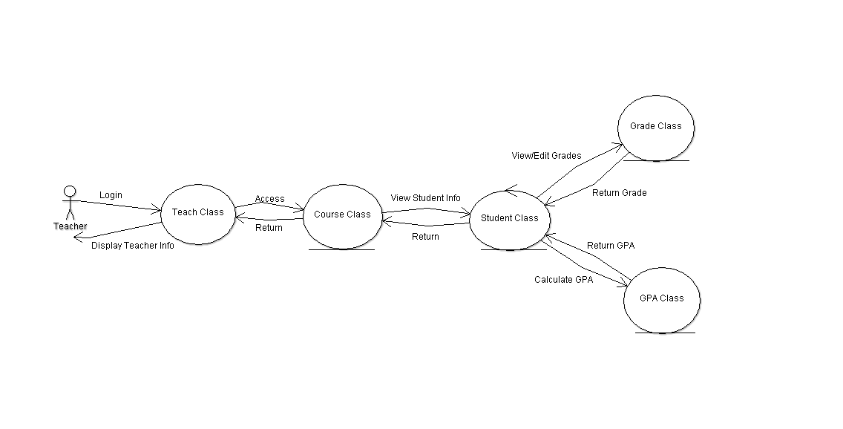
Collaboration Diagram

Slide 11
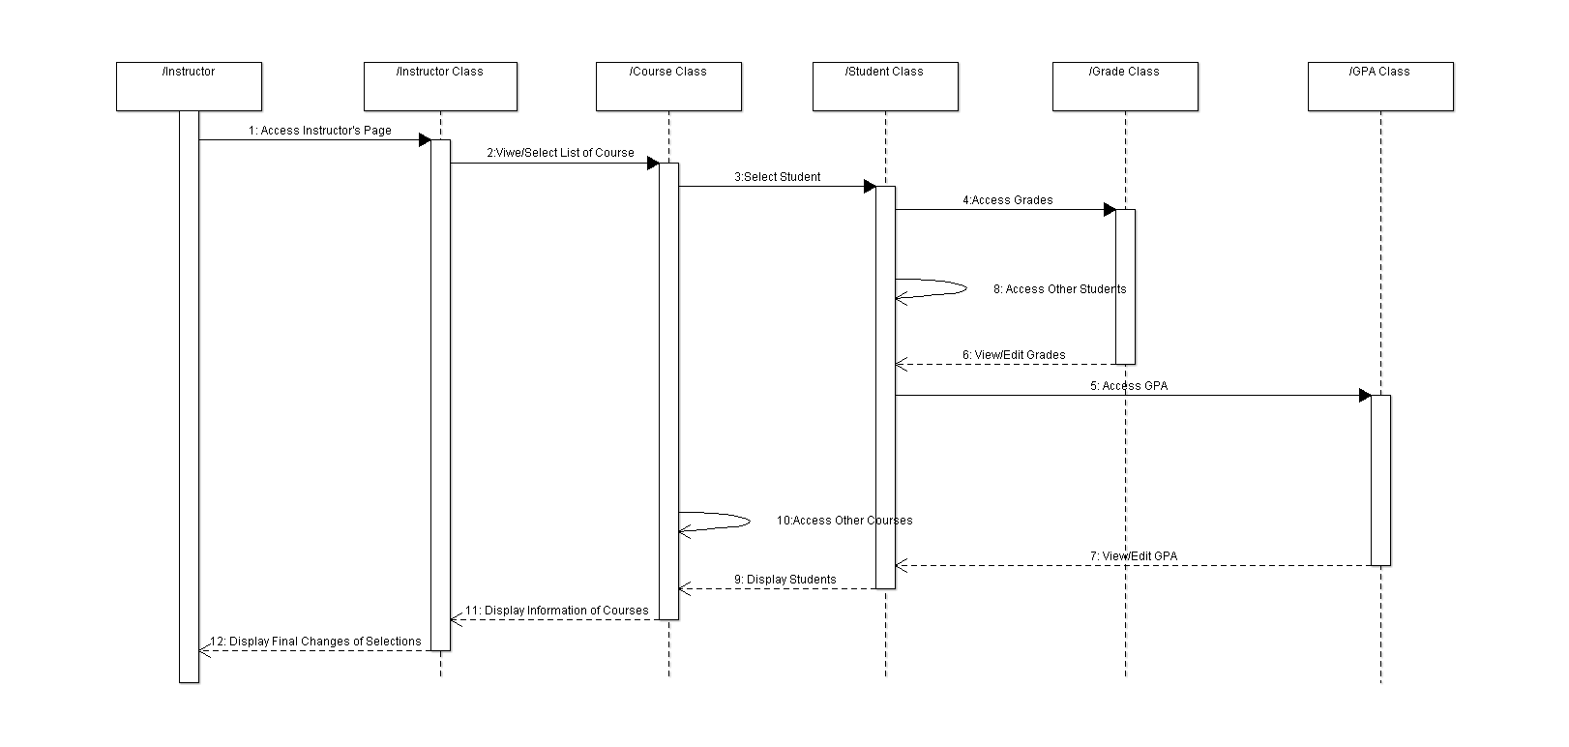
Sequence Diagram

Slide 12
Execution
Project coded in C# using Visual Studio Window Form Application
Used Microsoft SQL Server 2017 RDBMS for Database
GitHub for version control
Slack for team communication

